Slide 1
Jermyn Borough Council Meeting
7/23/2026

Slide 2
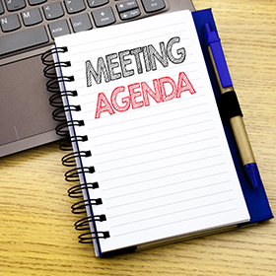
Meeting Agenda
July 23, 2026
CALL TO ORDER
PLEDGE OF ALLEGIANCE
ROLL CALL
PREVIOUS MEETING MINUTES
TREASURER REPORT/BILLS PAYABLE
CORRESPONDENCE
SECRETARY REPORT
PUBLIC COMMENT
PROFESSIONAL REPORTS
  MAYOR/POLICE/250 CELEBRATION REVIEW
  SOLICITOR
  FIRE CHIEF
  TAX COLLECTOR
  KBA
  EMA
  CODE OFFICER
COMMITTEE REPORTS
  SAFETY
  FINANCE
  SHADE TREE
  RECREATION
  NORLACK
FOLLOW UP TO JUNE MEETING ITEMS
  SIGNS FOR MAYOR NAME CHANGE
  RAILS AND TRAILS CONTACT
  TREE REMOVAL AND TRIMMING
  DPW BUILDING CEILING BIDS
  CURB REPAIR GARFIELD/CLEVELAND
EBIKE ORDINANCE
QUALITY OF LIFE ORDINANCE
PLANNING COMMISSION VACANCIES
ZONING HEARING BOARD VACANCIES
REC COMMITTEE APPOINTMENTS
NEW BUSINESS/ADJOURNMENT

Slide 3
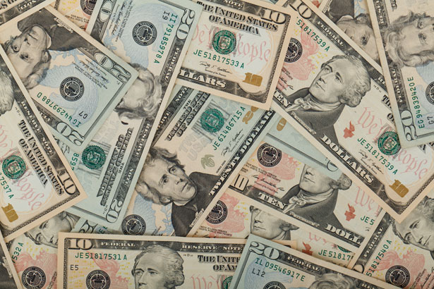
Treasurer’s report
7/23/2026
ASSETS
Checking/Savings
American Rescue Plan Fund 91,619.50
Capital Reserve - DPW 1,325.74
Capital Reserve - Police 5,289.82
Crime Watch Fund 222.69
General Fund - Community 230,898.32
General Fund - FNB 3,432.29
Holiday Lights Fund 400.59

Slide 4
Treasurer’s report
Investment - General Fund 1,195.32
Investment - Liquid Fuels 26,325.22
Investment - Paving Fund 1,207.57
Investment - Recycling 131.14
Investment - Refuse 188.42
Liquid Fuels - FNB 29,413.67
Petty Cash 194.00
Recreations Fund 19,849.32
Recycling - Community 10,141.26
Refuse Checking - FNB 288,648.75
Total Checking/Savings 710,483.62

Slide 5
Treasurer’s report
200000 · Accounts Payable 14,696.04
Long Term Debt 412274.09

Slide 6


